Slide 1



DBMS PROJECT
CO-202
Airport Management System
Created By:
Syed Mohammad Wali (2K22/CO/463)
Syed Muneeb Ali (2K22/CO/464)
(2023-24)

Slide 2

01
Project Overview
02
Objectives and scope of the system
Agenda
03
ER Diagram
27.06.2024
04
Assumptions and Limitations
05
Future Enhancements

Slide 3


Project Overview
The Airport Management System project was created to enhance the efficiency of managing airports, airlines, and passenger services. Despite encountering challenges, the project successfully implemented key features, improving overall airport operations.
Project Goals
Streamline operations for efficiency.
Enhance passenger experience.
Optimize resource allocation.
Facilitate communication and collaboration.
Improve financial management.

Slide 4
Summary of Key Features:
Centralized Data Management: Unified platform for airport, airline, and passenger information.
Automated Processes: Streamlined tasks like flight scheduling and check-in for efficiency.
Real-time Updates: Instant flight status and gate changes for seamless travel.
Resource Optimization: Efficient allocation of gates, terminals, and personnel.
Compliance and Safety: Adherence to aviation regulations for passenger security.
Communication Tools: Enhanced collaboration among staff and stakeholders.

Slide 5


Objectives and scope of the system
Efficient Flight Management- Accurately track and manage flight schedules, including arrivals, departures, and durations.
Comprehensive Passenger Information System- Maintain detailed records of passenger information, including unique identification using passenger ID and passport number.
Effective Ticketing System- Ensure accurate fare calculation based on airline, source, destination, journey date, and class.
Robust Employee Management- Track employee details and roles effectively using unique SSN identification.

Slide 6

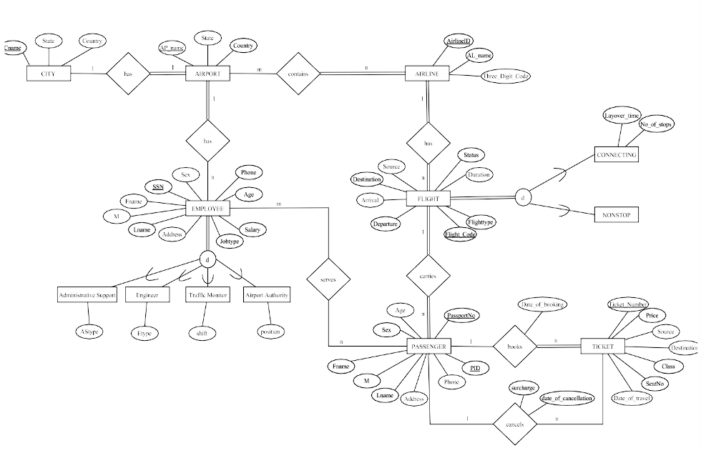
ER DIAGRAM
The ER Diagram consists of the 7 main entities CITY, AIRPORT, AIRLINE, FLIGHT, PASSENGER, TICKET, EMPLOYEE and the relationships between them.

Slide 7


ASSUMPTIONS AND LIMITATIONS
The system is designed for international flights only.
A city has at most one international airport.
For connecting flights, the aircraft and airline remain the same during layovers.
The system considers a simplified set of job roles available at the airport.

Slide 8


Future Enhancements
Our project definitely has some scope for future enhancements:
Cargo Management Module
Environmental Impact Monitoring
Multi-Airport Management
Scalability Improvements

Slide 9

CONCLUSION
Successful transformation of airport operations achieved through meticulous planning and innovative technology implementation.
Enhanced passenger experience realized through seamless processes and real-time updates.
Challenges overcome through dedicated teamwork and unwavering commitment to excellence.
Anticipating continued success and future advancements in airport management as we embrace new opportunities.

Slide 10

Thank you!

